Slide 1
Efficient Employee Data Management on ESP32 with SPIFFS
By
Viveksai chintha
Under guidance of
Antony Rajeev sir

Slide 2
Introduction:
Ladies and gentlemen, esteemed colleagues, and project evaluators, I am thrilled to present to you today our innovative project titled "ESP32-Based Employee Database Management System with SPIFFS". In an era where efficient management of employee data is crucial for organizational success, our project aims to revolutionize this process using cutting-edge technologies and a robust framework.

Slide 3
Project Overview
At the heart of our project lies the ESP32 microcontroller, renowned for its versatility and reliability in IoT applications. Leveraging the ESP-IDF framework within the VS Code environment, coupled with FreeRTOS and C programming, we have developed a firmware capable of seamlessly interfacing with SPIFFS (SPI Flash File System) to manage employee data efficiently.
Key Components:
Our project comprises several key components essential for its functionality:
ESP32 Microcontroller: Serving as the backbone of our system, the ESP32 provides the necessary computational power and connectivity options for seamless integration.
SPIFFS (SPI Flash File System): This lightweight file system offers a reliable storage solution for organizing and accessing employee data with minimal overhead.
Employee Database Schema: Designed to accommodate essential employee details such as name, ID, age, position, and salary, our database schema ensures structured and efficient data management.

Slide 4
Objective
The primary objective of this project is to develop a streamlined employee data management system that offers the following benefits:
Efficient storage and retrieval of employee details.
Scalability to accommodate a growing workforce.
Ease of integration with existing systems and applications.
Enhanced data security and reliability.

Slide 5
Background
In today's dynamic corporate landscape, the effective management of employee data is paramount for organizational efficiency and growth. Traditional methods of data storage and retrieval often fall short in meeting the evolving demands of modern enterprises. Recognizing this challenge, our project endeavors to revolutionize employee data management using cutting-edge technologies and a robust framework.
Key Features of the Firmware:
Custom Data Structures: Leveraging the power of C programming, our firmware utilizes structured data types to efficiently capture and organize employee details, including name, ID, age, position, and salary.
FreeRTOS Integration: Employing FreeRTOS, a leading real-time operating system, our firmware implements task management and synchronization mechanisms, ensuring seamless multitasking and intertask communication.
Semaphore-based Communication: Through the strategic use of semaphores, our firmware facilitates safe and efficient communication between tasks, minimizing resource contention and enhancing system responsiveness.
SPIFFS Storage: Harnessing the capabilities of SPIFFS (SPI Flash File System), our firmware provides a reliable and scalable storage solution for persistently storing employee data, enabling rapid access and retrieval.
API/Functions for Database Operations: We have developed a comprehensive set of API functions to facilitate seamless interaction with the employee database, including functionalities for writing, reading, and updating employee records.
Efficient Data Retrieval: Our firmware includes specialized functions to retrieve employee details based on unique identifiers, such as employee ID, ensuring rapid and accurate access to relevant information.
Dynamic Data Addition: With dedicated functions for adding new employee details to the database, our firmware empowers organizations to seamlessly integrate new personnel into their workforce management system.

Slide 6
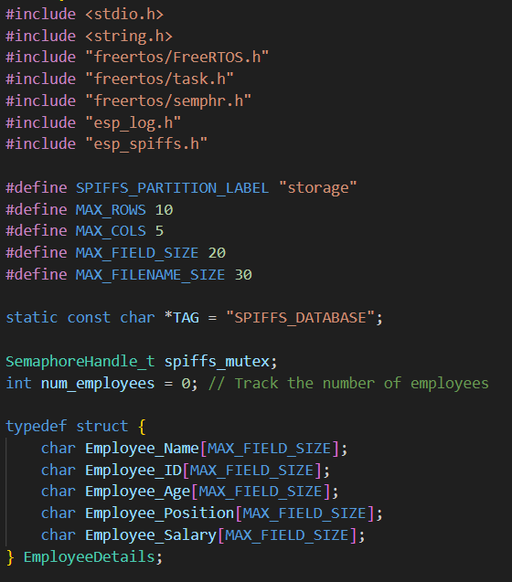
Implementation
Firmware:

Slide 7
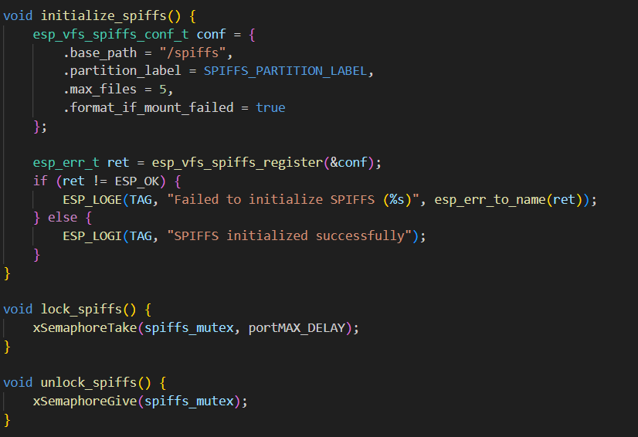
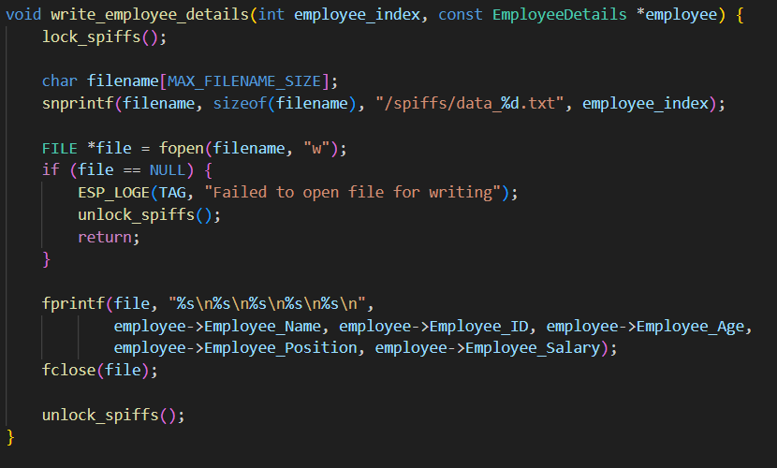

Slide 8
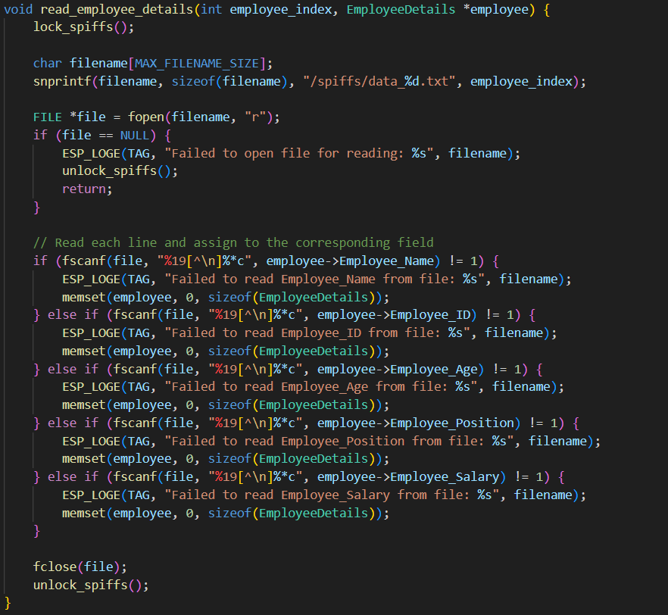
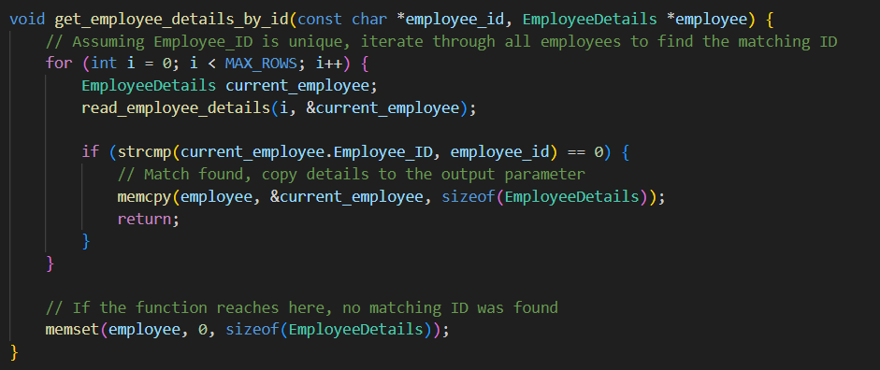

Slide 9
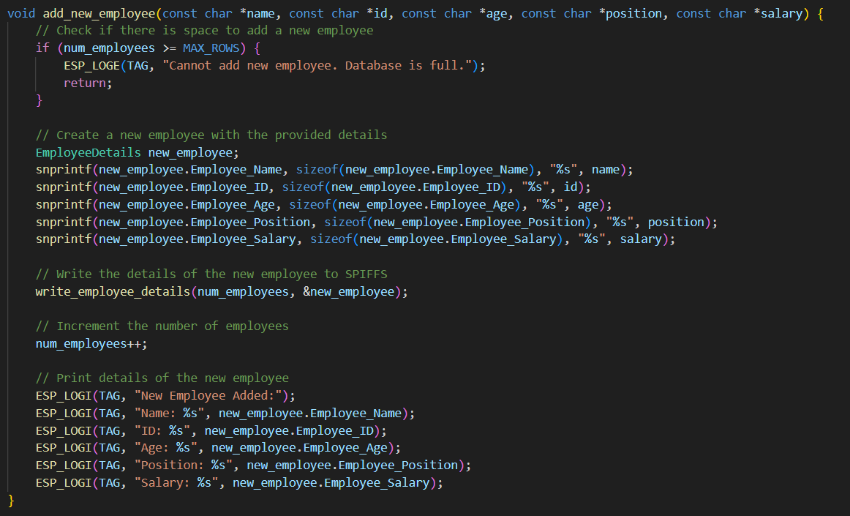
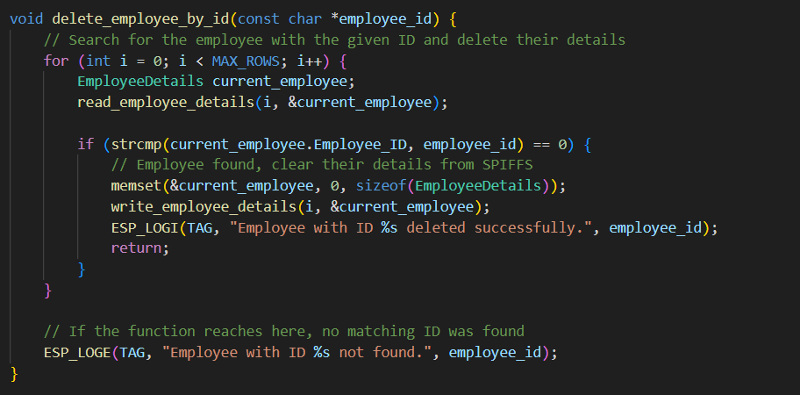

Slide 10
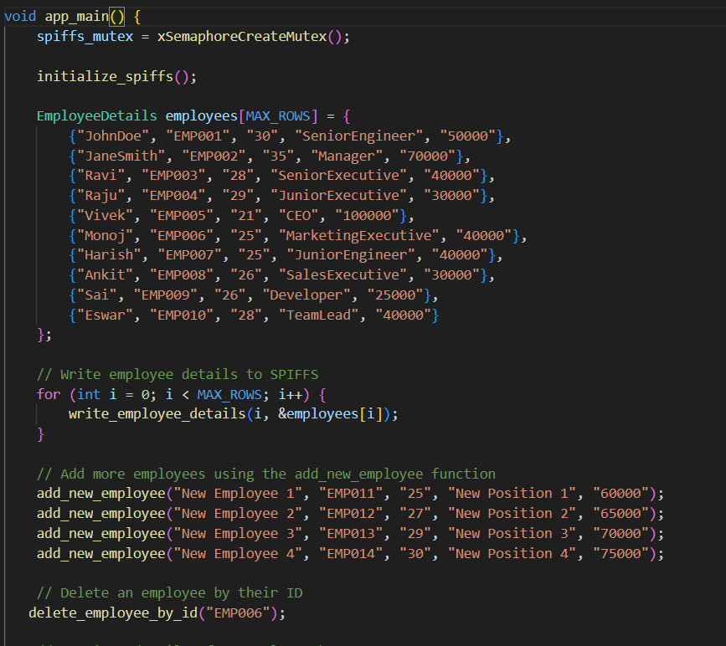
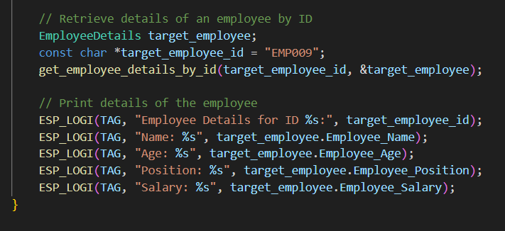

Slide 11
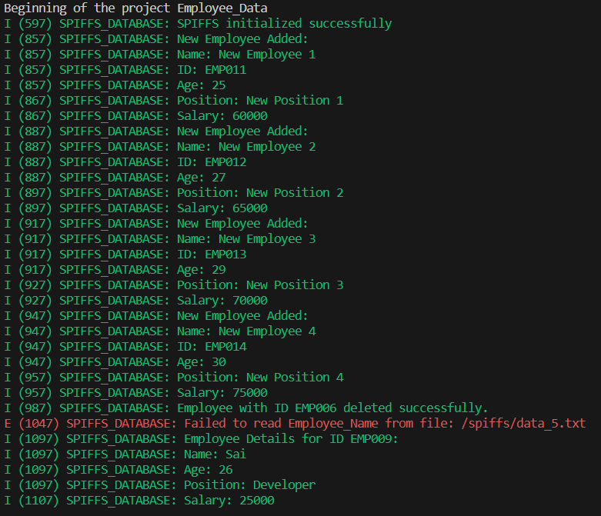
Results

Slide 12
Demo
Here is the small demo of the project.

Slide 13
Challenges and Solutions
Throughout the development process, our team encountered several challenges that required careful analysis and problem-solving. These challenges spanned various aspects of the project, from understanding key concepts to implementing FreeRTOS functionalities.
Understanding Key Concepts:
Error Resolution: We encountered numerous errors during the development phase, ranging from syntax errors to more complex issues related to hardware interactions and firmware configurations.
Utilization of Resources: To address these errors, we relied on a combination of self-study, consultation of technical documentation, and active participation in online communities such as Stack Overflow. These resources provided invaluable insights and guidance in resolving issues efficiently.
Integration of FreeRTOS Concepts:
Semaphore Implementation: Integrating FreeRTOS concepts, such as semaphores, posed a significant challenge due to their intricacies and potential for deadlock or race conditions.
Learning from External Sources: To gain a deeper understanding of FreeRTOS concepts and their practical implementation, we turned to online resources such as YouTube lectures and tutorials. These supplementary materials offered practical examples and real-world insights that complemented our learning process.

Slide 14
Conclusion
In conclusion, "ESP32-Based Employee Database Management System with SPIFFS" represents a significant advancement in modernizing employee data management practices. By harnessing the power of ESP32, ESP-IDF, FreeRTOS, and SPIFFS, we have created a robust solution that empowers organizations to streamline their HR processes effectively.

Slide 15
References
YouTube Lectures:
DigiKey. (2021, January 4). Understanding FreeRTOS concepts [Video]. YouTube. https://www.youtube.com/watch?v=F321087yYy4&list=PLXyB2ILBXW5FLv7j2hLcX6sAGbmHOJxX8&index=1 &pp=iAQB

Slide 16
Acknowledgements
Antony Rajeev:
I would like to express my sincere gratitude to Mr. Antony Rajeev sir for his unwavering support, guidance, and mentorship throughout the development of this project. His expertise, dedication, and willingness to assist at any time have been invaluable, and I am immensely grateful for his contributions.
SURETRUST:
I extend my heartfelt thanks to SURETRUST for providing the embedded systems course that laid the foundation for this project. The comprehensive curriculum, hands-on training, and support from the SURETRUST team have been instrumental in shaping my understanding and skills in embedded systems development.

Slide 17

Questions

